Slide 1
CEN 414:Computer Software Engineering I
Fundamental of Object-Oriented Design.
BY OMORUYI O.

Slide 2
Topics (Module 2 Part B)
Language Basics(e.g. JAVA, C#, Python): Standard input and output statements. Escape sequences, math class.

Slide 3
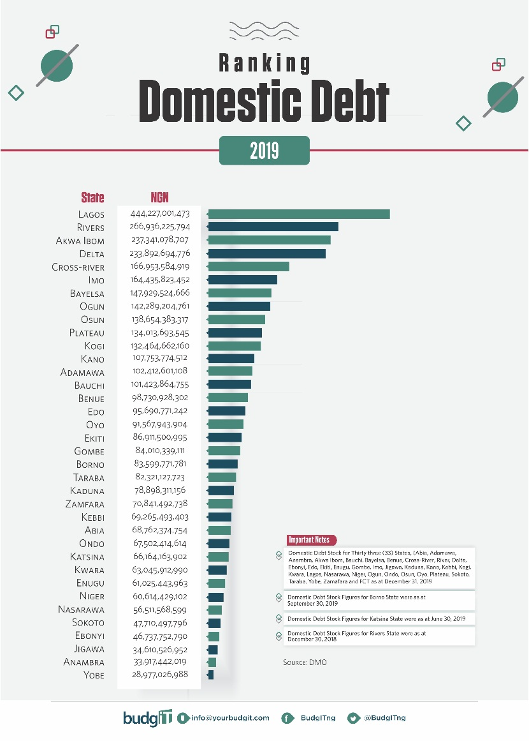
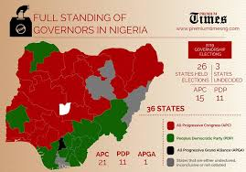
Assignment Two Infographics/ Statistical Presentations

Slide 4
Statistics for Assignment 2
Population forecast per state (2006-2016)
Labour Force per state (Q1, 2017 – Q2, 2020)
Unemployment (Q1, 2017 – Q2, 2020)
IGR per state (2015-2020)
FAAC per state (2015-2020)
*(include male/female breakdown where given)

Slide 5
Standard input and output statements
OUTPUT
Java- (PrintStream class)
System.out.print()
System.out.println()
Python
print “text”- – python2.x
print x – python2.x
print() – python3.x
println() – python3.x

Slide 6
Standard input and output statements
INPUT
Java
import java.util.Scanner;
// create an object of Scanner
Scanner input = new Scanner(System.in);
Python
Input()

Slide 7
Examples
Java
// String input
String name = myObj.nextLine();
// Numerical input
int age = myObj.nextInt();
double salary = myObj.nextDouble();
Python
n = int(input('Enter a number: '))

Slide 8
Character escape codes(Java)
\n Newline
\t Tab
\b Backspace
\r Carriage return
\f Formfeed
\\ Backslash
\’ Single quote
\” Double quote
\ddd Octal
\xdd Hexadecimal
\udddd Unicode character

Slide 9
Arithmetics in Java
Operator Meaning Example
+ Addition 3 + 4
– Subtraction 5 – 7
* Multiplication 5 * 5
/ Division 14 / 7
% Modulus 20 % 7

Slide 10
References
Lemay, L., Perkins, C. L., & Morrison, M. (1999). Java in 21 Days. Sama Publishing.

